Slide 1
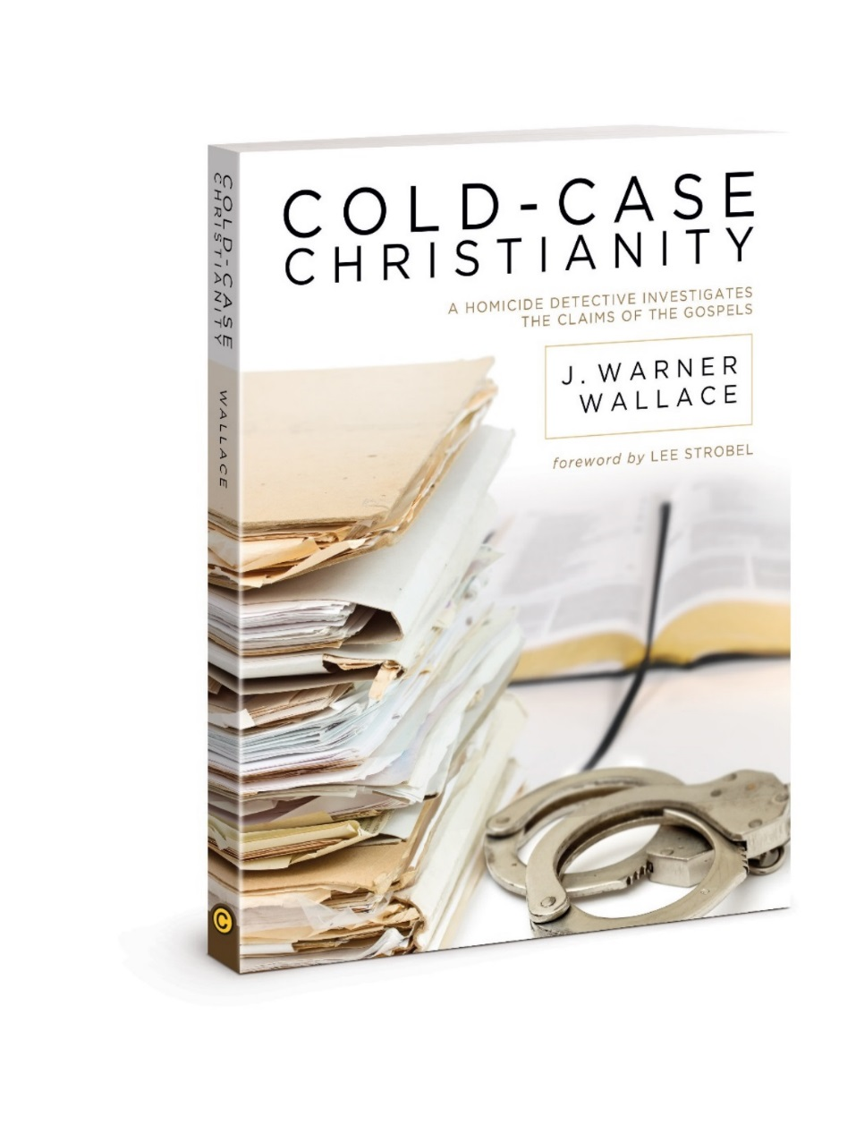
Chapter 4
Test Your Witnesses
Notes:
How do you tell if a witness is legitimate?

Slide 2
Questions asked to jurors about witnesses
1.)How well could they see, hear, or perceive
2.)How good is their memory?
3.)How did they behave while testifying
4.)Did the witness understand and answer the questions or was he evasive?
5.)Does the witness have relevant biases/prejudices? (ie. family or romantic relationship)
6.)What is witnesses attitude about the case or about testifying?
7.)Any inconsistencies with the witness' testimony?
8.)How reasonable is testimony compared to all other evidence?
Notes:
These guiding questions come from the ”Judicial Council of California, Judicial Council of California Criminal Jury Instructions, CalCrim Section 105”

Slide 3
Questions asked to jurors about witnesses
9.)Did any evidence disprove or validated what he said?
10.)Did witness claim to be untruthful about anything?
11.)Is his character known for truthfulness?
12.)Does he have felonies or a history of breaking laws?
13.)Any conduct of the witness whether current or past affects his believably?
14.)Does witness benefit from giving testimony? Did someone pay him to give it? Does he get less time in jail?
15.)Has witness ever been untruthful in the past?
16.)Does witness have a motive to lie?

Slide 4
Witness Credibility
Example: Michael Jackson’s 2003 child molestation case
Victim’s mother was a witness, but the defense pointed out that she had a shoplifting incident in 1998, which made some jurors discredit her as a trustworthy witness.
Notes:
In California, jurors are instructed this about witness testimony: ”If you decide that a witness deliberately lied about something significant in this case, you should consider not believing anything that witness says. Or, if you think the witness lied about some things, but told the truth about others, you may simply accept the part that you think is true and ignore the rest.
Judicial Council of CA Criminal Jury Instructions, CalCrim Section 105

Slide 5
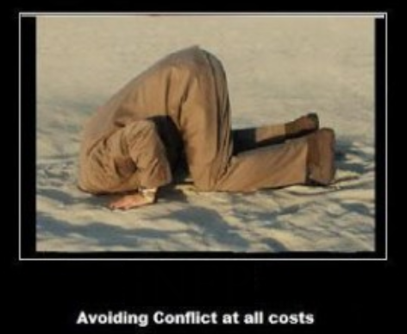
Can They Be Verified?
Was witness observation verified by another piece of evidence?
Does witness observation conflict with other evidence?
Notes:
-Some would say if a witness conflicts with a piece of evidence, they cannot be trusted. Not so fast...

Slide 6
Eyewitness Conflicts with Evidence?
Jurors are instructed to be cautious not to automatically disqualify a witness just because some part of his or her statement may disagree with an additional piece of evidence or testimony: “Do not automatically reject testimony just because of inconsistencies or conflicts. Consider whether the differences are important or not. People sometimes honestly forget things or make mistakes about what they remember. Also, two people may witness the same event yet see or hear it differently”
Notes:
Another quote from CA criminal jury instructions.
Disagreements are not automatic disqualifiers for witness testimony.

Slide 7
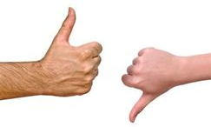
Why Can’t They All Agree?
The more witnesses, the more likely there will be points of disagreement
Contradictions in testimony often easy to explain when you learn about a witness’ perspective both visually and personally

Slide 8
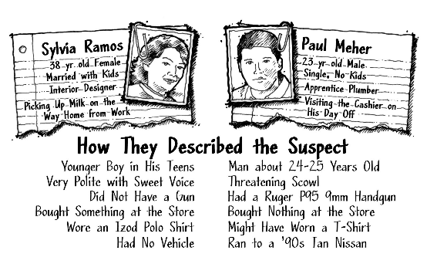
Grocery Robbery – 2 accounts
Notes:
The police reports read as in the picture.
Once the investigator talked to the witnesses, things began to make more sense. Sylvia was waiting in line behind the suspect and never suspected any issue since the suspect’s voice gave no tone of wrong-doing. She was behind him, so she couldn’t see a gun.
Paul was next to the cashier who was held at gunpoint and recognized the gun because his father owned the same model. Knowing the perspective of the witnesses makes all the difference determining the truth of what happened

Slide 9
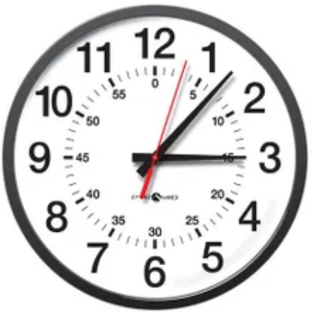
Early Recognition of Witnesses:
The order and timing that witnesses are interviewed can be crucial.
Time elapsed can tamper with witness testimony and make them less believable.
The sooner you can get witnesses, oftentimes the better the outcome.
The early church fathers and leaders recognized that the Gospels were the eyewitness testimony of the apostles, and they set the Gospels apart because of it.

Slide 10
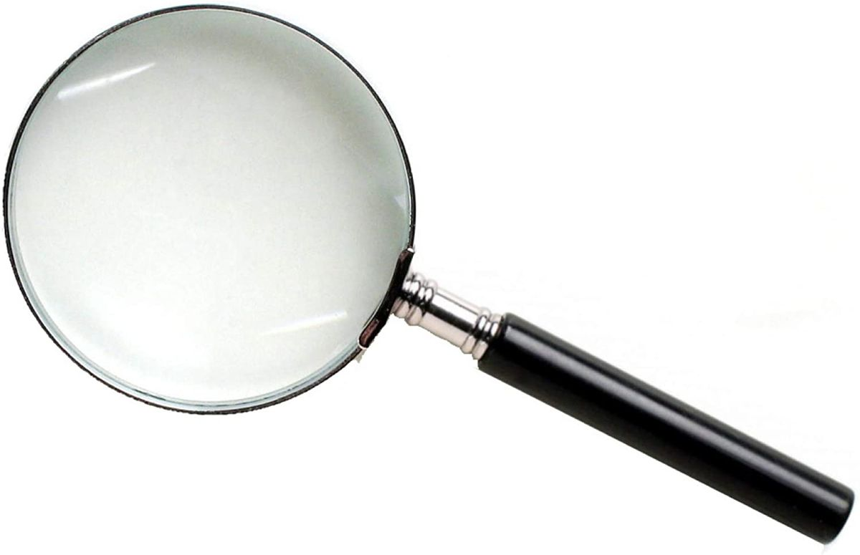
Early witness recognition example
The ancient Christian author Tertullian wrote in AD 212: "The same authority of the apostolic churches will afford evidence to the other Gospels also, which we possess equally through their means, and according to their usage - I mean, the Gospels of John and Matthew - whilst that which mark published may be affirmed to be Peter's whose interpreter Mark was"
Notes:
There are more than this. This is just an example. We will get more in depth in a latter chapter.

Slide 11
What about Late Testimony?
Late witness often knows what others said
Usually fills in gaps left by others
Not all memories created equal
Notes:
-Late - We notice how the gospel of John, which was written last leave out many details that the other gospels had because he wanted to fill in the gaps.
3.)memories – You might not remember what you did a year ago today, but you might be able to recall what you were doing on September 11, 2001. With late testimony, we have to ask if the memory of the witness is reliable.

Slide 12
Human Eyewitness Accounts
Human eyewitnesses make human observations
Normal for them not to agree on every detail
Normal to get details based on their perspective
Not normal for eyewitnesses to produce exact same accounts
Reliable eyewitnesses do not report information they could not have possibly known
Notes:
1.)Titanic survivors argue over whether the ship split in two as it sunk. Regardless of what the eyewitnesses tell us, we still know that the Titanic sunk.

Slide 13
Human Eyewitness Accounts
You ideally want each eyewitness to give their accounts separately
Otherwise, eyewitnesses can compare accounts and distort their testimony, leading to less accuracy. Not more.
When we match the perspective of an eyewitness with their observations, their testimony becomes clearer
Notes:
An example of perspective of an eyewitness in the Bible (next slide)
ie.) At the scene of a crime, it was raining at the scene and the police on the scene allowed the witnesses to stay in a squad car to keep dry. That is the worst thing you can do. You risk they will compare their recollection of events and change their story to be consistent with the others.

Slide 14
Gospel Writers - Eyewitnesses
Peter identified himself as a "witness of the sufferings of Christ"(1 pet. 5:1).
and as of of the many "eyewitnesses of His majesty" (2 pet. 1:16-17).
The Apostle John said he wrote as an eyewitness when he described the life and death of Jesus and as the "disciple who is testifying to these things and wrote these things"(John21:24).

Slide 15
Gospel Writers - Eyewitnesses
John said that He was reporting "what we have heard, what we have seen with our eyes, what we have look at and touched with our hands" (1 John 1:1.)
one "of the men who have accompanied us all the time that the Lord Jesus went in and out among us--beginning with the baptism of John until the day that Jesus was taken up from us" (Acts 1:21-22).
Notes:
The apostles repeatedly referred to themselves as witnesses and used that status as the foundation for everything they taught. The 12th “replacement” disciple was no different.

Slide 16
Gospel Writers - Eyewitnesses
Paul said that Jesus “appeared to James, then to all the apostles; and last of all, as to one untimely born, He appeared to me also” (1 Cor. 15:7–8).
Notes:
When the New Testament scripture was cannonized, the church fathers placed apostolic authority as the primary criteria for whether a book made the cannon. We will assess how and if the gospel writers can be trusted in a further lesson.

Slide 17
Biblical Inerrancy and Reliability
Personal perspectives may appear as contradictory or senseless when reading the Bible until you gather the right context
Existence of personal perspectives in the gospel accounts show us the statements were made by real people who did not collude to make all the details exactly the same

Slide 18
Conclusion
Unless you know how eyewitness testimony works and what to expect, it is easy to think witnesses are lying(or mistaken) when the accounts have what appear to be contradictions
Human eyewitness testimony is messy and based on individual life experiences, preferences, and worldviews
The seeming contradictions in the gospel writer accounts are what given them more credibility, not less

Slide 19
Still to Come
Were they Present
Were they Corroborated
Were they Accurate
Were they Biased to make a lie
Notes:
There are -
The Bible passes the witness test.
We still haven’t demonstrated that the gospel writers were Present to witness the resurrection
If their testimony is corroborated
Accurate about the resurrection
And if they had a bias to lie about the resurrection

Slide 20
for more information visit:
www.ColdCaseChristianity.com

